Slide 1
ELSEWeb meets SADI: Supporting Data-to-Model Integration for Biodiversity Forecasting
Nicholas Del Rio¹, Natalia Villanueva-Rosales¹, Deana Pennington¹, Karl Benedict², Aimee Stewart³ and Cj Grady³
University of Texas at El Paso Cyber-ShARE¹
University of New Mexico Earth Data Analysis Center²
University of Kansas Biodiversity Institute³

Slide 2
Outline
Use Case: Chihuahuan Desert
Understanding ELSEWeb and the Model Web
Streamlining data via Ontologies and SADI
ELSEWeb Experiment Example
Making Sense of Results Through Provenance

Slide 3
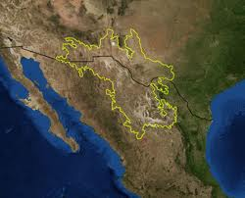
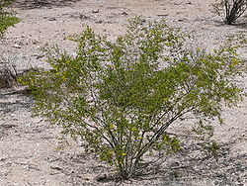
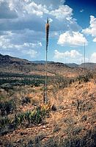
Use Case: Chihuahuan Desert Encroachment
Region: Northern Mexico, West Texas and Southern New Mexico
Terrain: Basins and Mountain Ranges
Climate: Mild Summer (35 – 40° C)
Flora:
Larrea Tridentata
Observation: the Chihuahuan desert has encroached on existing grasslands, resulting in an altered landscape.
Agave lechuguilla
Notes:
More informative title!!!! For example: the semantics of the scientific question

Slide 4
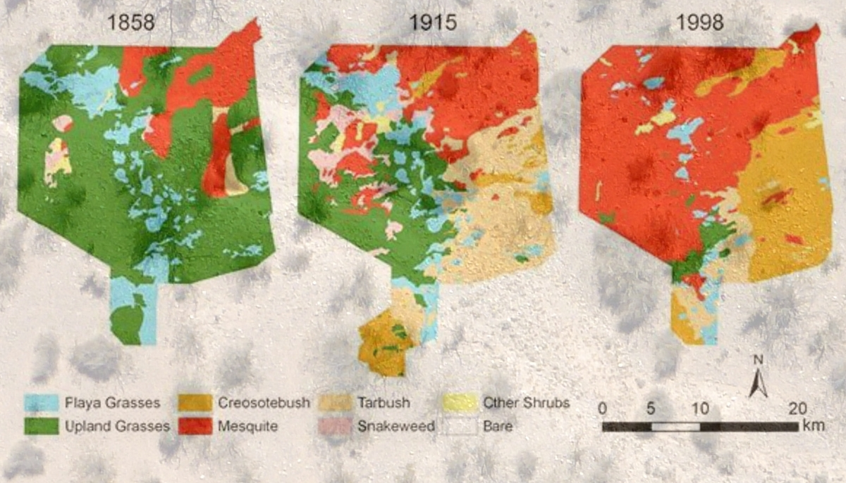
Transition from Grassland to Desert
http://cybershare.utep.edu/
Notes:
Add reference to cybershare

Slide 5
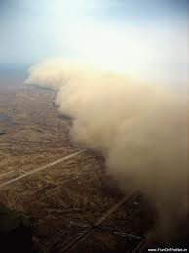
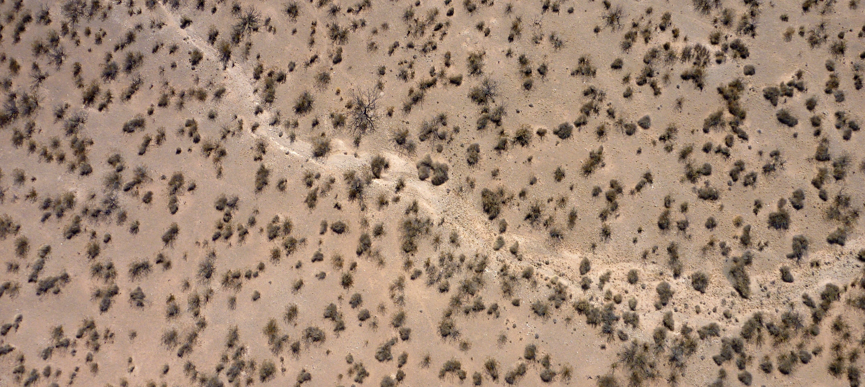
Implications of an Encroaching Desert Ecosystem
Sparse vegetation of the Chihuahuan desert
Dust storms containing allergens such as fungus
Sparse vegetation of mesquite shrubs leads to altered erosion patterns, creating an environment suitable for dust storms.
Notes:
Get high resolution pics from Fransca from viz wall. Get them from Frank ☺ Possible video, test to see if works. Be sure to give credit

Slide 6
Chihuahuan Related Inquiries
Predictions: If we move to hotter climates with more variable precipitation, will we get further encroachment in the desert?
Will we get more erosion?
Will we get higher flood events?
Species Distribution Models (SDM), such as Lifemapper, can provide insight:
“I want to model the transition from grassland to Chihuahuan desert during historic regions of drought”
http://lifemapper.org/
Notes:
List all people at teams: lifemapper, edac, and UTEP. Include all people even non-authors. Introduce in the beginning with logos and picture of peoples.

Slide 7

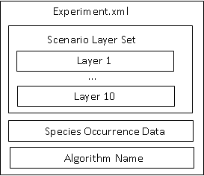
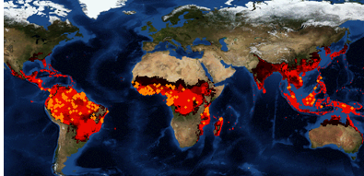
Species distribution modelers exposed as RESTful services
Output
Supported modeling algorithms:
BIOCLIM
Artificial Neural Network
Maximum Entropy - ATT Implementation
Climate Space Model
GARP with Best Subsets
Maximum Entropy
Scientists need data and transformation facilities to generate Lifemapper models

Slide 8
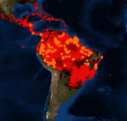
A Pattern for Data-to-Model Web
“This Model Web would be a system of interoperable computer models and databases communicating primarily via web services” – Geller 2009
Modeling Environment
(Web Coverage Service)
Web Client
Modeling Service (Web Processing Service)
Species Data (Database)
Data and Models are exposed as Open Geospatial Consortium (OGC) services
The pattern was suggested and employed by the eHabitat system

Slide 9
Potential Limitations of Pattern
Where can I find relevant data?
Discovery Limitations
Interface Requirement Disparities: formats and type transformations
What transformations are required to satisfy requirements?
Is my layer set compatible?
Web Client
Modeling Service
What metadata standard(s) are being employed? Is the data relevant for my purposes?
Metadata interpretation

Slide 10

Earth, Life, and Semantic Web
ELSEWeb streamlines the flow of heterogeneous geographic, social, and geological data into Lifemapper modeling services through semantic mediation
Earth Data Analysis (EDAC) WCS Data (Lots of PRISM and MODIS Data)
1
Supports Data Discovery
Semantic Metadata
2
Provides an extensible set of transformation services
Adapter KB
Lifemapper
(RESTful)
3
Generates adaptor execution plans
Orchestration Agent
Lifemapper Species Data
ELSEWeb Semantic Mediation Layer

Slide 11
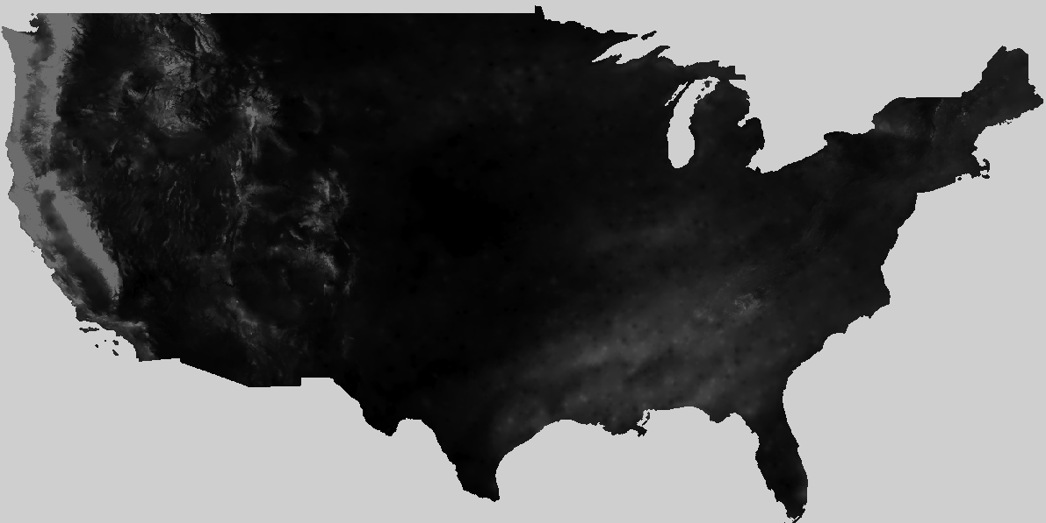
ELSEWeb Components (Reuse)
Metadata
OWL
Metadata
Individuals
EDAC Data
1
Semantic
MetaData
Selector Service
http://biordf.net/cardioSHARE/
Adaptor Service 1
2
Adaptor
KB
3
cardioSHARE
(handles adaptor orchestration)
Adaptor Service n
Experiment Specifications RDF
Model Generation Query (SPARQL)
Lifemapper Service
SADI Service OWL
http://sadiframework.org/content/
Notes:
Add reference to pellet and cardioshare

Slide 12
Harvesting from Earth Data Analysis Center
1
CF Keywords
GCMD
Categories
WCS Get Capabilities
XML
FGDC XML
ISO
19115
Topic
Categories
Metadata Store
Harvesting: translate metadata descriptions into our ELSEWeb data model
Semantic
Metadata
Data Store
WCS Data = Multipart MIME = Payload Tiff + Metadata
Harvested Data Breakdown of 6656 Datasets
CF | dew_point_temperature | degrees celsius * 100 | 1532
 | precipitation_amount | Millimeters times 100 | 1532
 | air_temperature | degrees celsius * 100 | 3064
GCMD_Science | LAND SURFACE TEMPERATURE | bit field | 424
 | VEGETATION INDEX | unitless | 104

Slide 13
Desirable Semantic Metadata Model
The ELSEWeb Semantic Data model was designed to support the following concerns:
What kind of data?
Observation Ontology (OBOE): Describes data in terms of entities (i.e., the physical thing being measured and it characteristics (i.e., properties)
Where can I get the data?
Data Catalog Vocabulary (DCAT): Describes non-RDF datasets in terms of spatial/temporal coverage, format, and themes
How was the data generated?
Who was responsible for publishing?
When was it generated?
Provenance Ontology (PROV-O): W3C recommendation for interchanging provenance modeled in PROV

Slide 14
Partial Semantic Data Model
Catalog
dcat:dataset
Dataset
dcat:distribution
Distribution
rdfs:subClassOf
dc:temporal
WCSCoverage
Dataset
dc:spatial
PeriodOfTime
Location
oboe:ofCharacteristic
oboe:measurementFor
Characteristic
Measurement
Observation
DCAT
oboe:ofEntity
prov:wasAssociatedWith
ELSEWeb
Entity
OBOE
Agent
PROVO
http://ontology.cybershare.utep.edu/ELSEWeb/elsewebdata.owl

Slide 15
Mapping CF to OBOE
CF vocabulary couples entities with measurements, so we need to decompose:
dew_point_temperature
Entity
Characteristic
Prepackaged with
OBOE.owl
Atmospheric Feature
Temperature
DewPoint
Need to reuse other ontologies such as SWEET or define own classes.
An ELSEWeb extension

Slide 16
Describing Adaptors using SADI
2
Adaptor services perform operations such as:
Data selection – binds specifications to satisfactory data
Data transformations – transform structure or format of data
Modeling – implement modeling algorithm
Adaptor services are implemented as Semantic Automated Discovery and Integration (SADI) Services:
outputParameter
Parameter
ServiceDescription
Operation
objectType
hasOperation
inputParameter
owl:Class
Input/Output Class
SADI OWL
Adaptor KB

Slide 17
An Example SADI Service: Tiff Scenario Extraction
Tiff Scenario Extraction Service: extracts Tiff payload from multipart MIME WCS response messages
Distribution
rdfs:subClassOf
elseweb:hasWCSCoverageDistribution 1..10
WCSCoverage
Distribution
WCSScenario
myGrid:inputParameter
SADI OWL
rdfs:subClassOf
WCSPayloadExtractor
ELSEWeb OWL
myGrid:outputParameter
DCAT
TiffExtracted
WCSScenario
Elseweb:hasExtractedTiffScenario
TiffScenario
http://visko.cybershare.utep.edu/sadi-services-elseweb/
17

Slide 18
Coordinating Adaptor Execution
3
Reason With Pellet
Execute SADI service
Check query pattern
The carioSHARE client executes SADI services in an attempt to satisfy some query
Adaptor KB
select ?experiment ?modelURL
from <http://ontology.cybershare.utep.edu/experiment-1.owl>
where
{
?scenario a scenario:SatisfiedScenarioRequirements.
?scenario scenario:hasSatisfactoryWCSScenario ?wcsScenario.
?wcsScenario a scenario:TiffExtractedWCSScenario.
?wcsScenario scenario:hasExtractedTiffScenario ?tiffScenario.
?experiment lifemapper:hasLifemapperScenario ?tiffScenario.
?experiment lifemapper:hasModel ?model.
?model lifemapper:hasModelURL ?modelURL.
?experiment a lifemapper:CompletedExperiment.
}
cardioSHARE
Experiment Specifications RDF
Model Generation Query (SPARQL)
Referenced via FROM clause in query

Slide 19
Experiment Specification Ontology
hasModelingAlgorithm
ExperimentSpecification
ModelingAlgorithm
hasScenarioRequirements
hasOccurrenceSetID
hasModelingParameter
WCSScenario
Requirements
OccurrenceSet
Data
Parameter
Class: ExecutableExperiment
EquivalentTo:
(hasLifemapperScenario some LifemapperScenario)
and (hasModelingAlgorithm some ModelingAlgorithm)
and (hasOccurrenceSetID some rdfs:Literal)
and (hasScenarioLayerUnits some rdfs:Literal)
SADI services support this transformation
TiffScenario =
LifemapperScenario
ExecutableExperiment
hasScenario
Lifemapper SADI services ingests ExecutableExperiments
http://ontology.cybershare.utep.edu/ELSEWeb/lifemapper.owl

Slide 20
A Partial Chihuahuan Desert Experiment Spec.
The environment scenario consists of five layers
Individual: <http://ontology.cybershare.utep.edu/ELSEWeb/experiments/experiment-1.owl#wcsScenarioRequirements>
Types:
scenario:WCSScenarioRequirements
Facts:
scenario:hasWCSDistributionRequirement2 <experiment-1.owl#distributionRequirement2>,
scenario:hasWCSDistributionRequirement4 <experiment-1.owl#distributionRequirement4>,
scenario:hasWCSDistributionRequirement3 <experiment-1.owl#distributionRequirement3>,
scenario:hasWCSDistributionRequirement1 <experiment-1.owl#distributionRequirement1>,
scenario:hasWCSDistributionRequirement5 <experiment-1.owl#distributionRequirement5>
Layer 3 should be bound to Surface Temperature within some space/time frame
Individual: <experiment-1.owl#distributionRequirement3>
Types:
scenario:WCSDistributionRequirement
Facts:
terms:spatial <experiment-1.owl#region1>,
scenario:hasEntityClass elsewebdata:SurfaceLayer,
scenario:hasCharacteristicClass <oboe-characteristics.owl#Temperature>,
terms:temporal <experiment-1.owl#duration3>

Slide 21
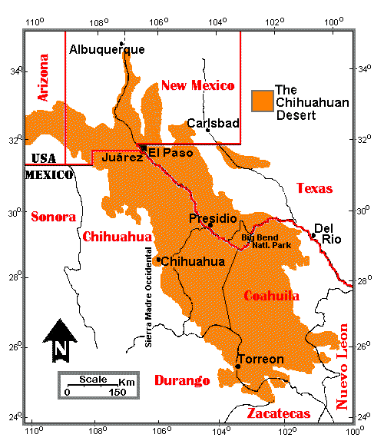
A Chihuahuan Desert Experiment Specification
Space and Time Constraints
Individual: <experiment-1.owl#region1>
Types:
elsewebdata:Region
Facts:
elsewebdata:hasUpperLatitude 35.0,
elsewebdata:hasRightLongitude -95.0,
elsewebdata:hasLowerLatitude 25.0,
elsewebdata:hasLeftLongitude -110.0
Individual: <experiment-1.owl#duration3>
Types:
elsewebdata:Duration
Facts:
elsewebdata:hasEndDate "0200-12-31T00:00:00-07:00"^^xsd:dateTime,
elsewebdata:hasStartDate "0201-02-28T00:00:00-07:00"^^xsd:dateTime

Slide 22
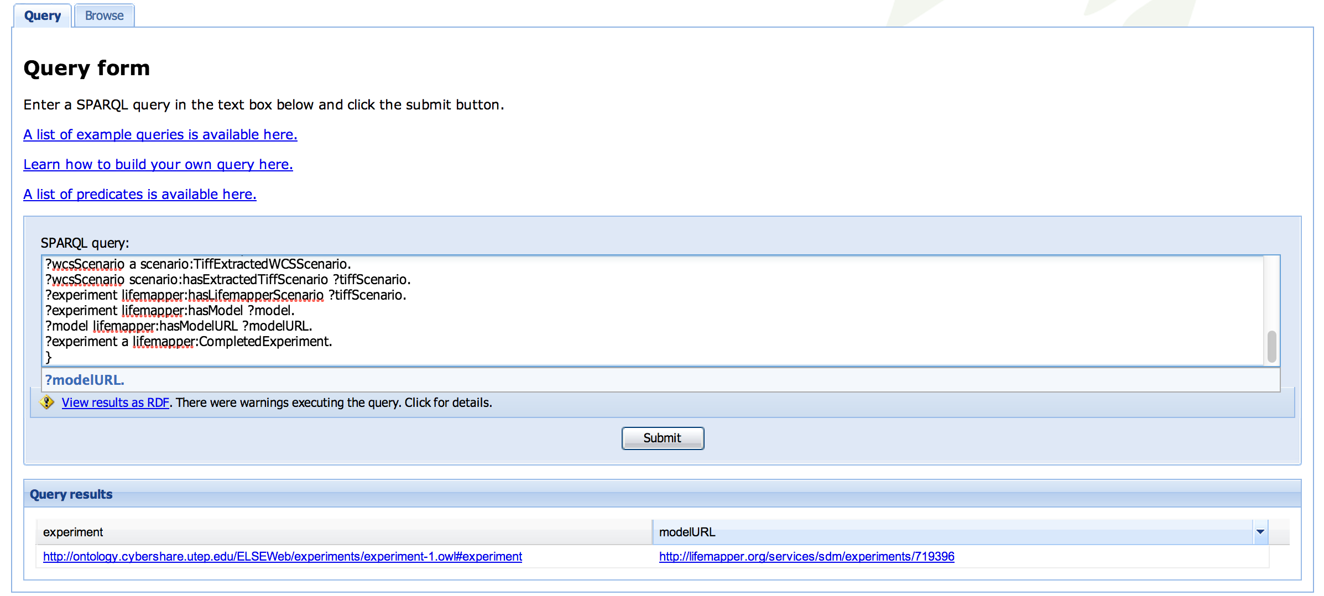
Interacting with cardioSHARE
Experiment SPARQL Query
Experiment Specification URI
Model URL Result
http://visko.cybershare.utep.edu/cardioSHARE-elseweb/

Slide 23
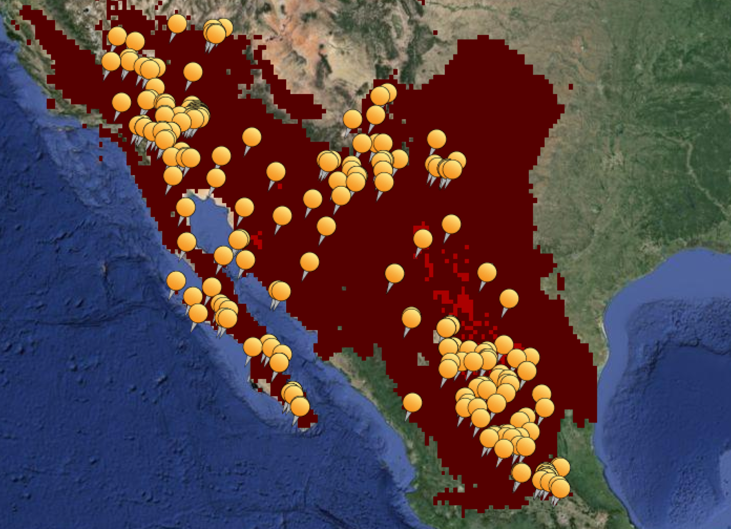
Chihuahuan Desert Model Result
Spread of Larrea Tridentata output from Lifemapper

Slide 24
ELSEWeb Goal Extensions
2
Denotes a duration of time encompassing a set of relevant environmental data
Data discovery, integration, transformation
1
These biomes are not defined solely by geographic coordinates; they are partially defined by its migrating flora (interpretation)
3
“I want to model the transition from grass lands to Chihuahuan desert (probably steppe), during historic periods of drought”
4
Drought denotes an event, that contextualizes a set of geospatial data within some space/time (interpretation)
ELSEWeb currently can support (1), but future work includes managing the complexities related to (2), (3), and (4)
Notes:
Identify the current and future work, perhaps by highlights. This is a work in progress, but we have some initial results for (1). This is achalleng that evolves but we are addressing the particular grant with was targeted with 1.

Slide 25
ELSEWeb and Provenance
Each SADI service is configured to capture the input and output RDF as uniquely identified named graphs
<rdf:Description rdf:about=“namedGraph_1384383646553.rdf">
<j.3:wasGeneratedBy>
<j.4:prov-sadi.owlSadiService rdf:about="http://elseweb.cybershare.utep.edu/WCSCoverageRequirementsService">
<j.3:used>namedGraph_1384383646232.rdf</j.3:used>
</j.4:prov-sadi.owlSadiService>
</j.3:wasGeneratedBy>
</rdf:Description>
…
Satisfied
WCS Scenario
Requirements
WCS Scenario
Requirements
Tiff
Scenario
Tiff Extraction
Service
wasGeneratedBy
derivedFrom
wasGeneratedBy
used
used
derivedFrom
WCS
Requirements Service
WCS Scenario
Tiff Extracted WCS Scenario
Notes:
Just glide by this one and say it is very recent work

Slide 26
Future Work – Tons of it!
Modeling:
connect to different models
work with different data providers
Provenance:
Aggregate SADI level provenance with lower level provenance from EDAC and Lifemapper
Visualization
Reasoning:
provide utility for users to identify events
associate changing regions with time

Slide 27
Acknowledgements
ELSEWeb is funded by NASA ACCESS grants NNX12AF49A (UTEP), NNX12AF52A (UNM), and NNX12AF45A (KU)
This work used re- sources from Cyber-ShARE Center of Excellence supported by NSF grant HRD-0734825 and HRD-1242122

Slide 28
Questions?
Nicholas Del Rio
UTEP Cyber-ShARE
ndel2@miners.utep.edu

